Slide 1

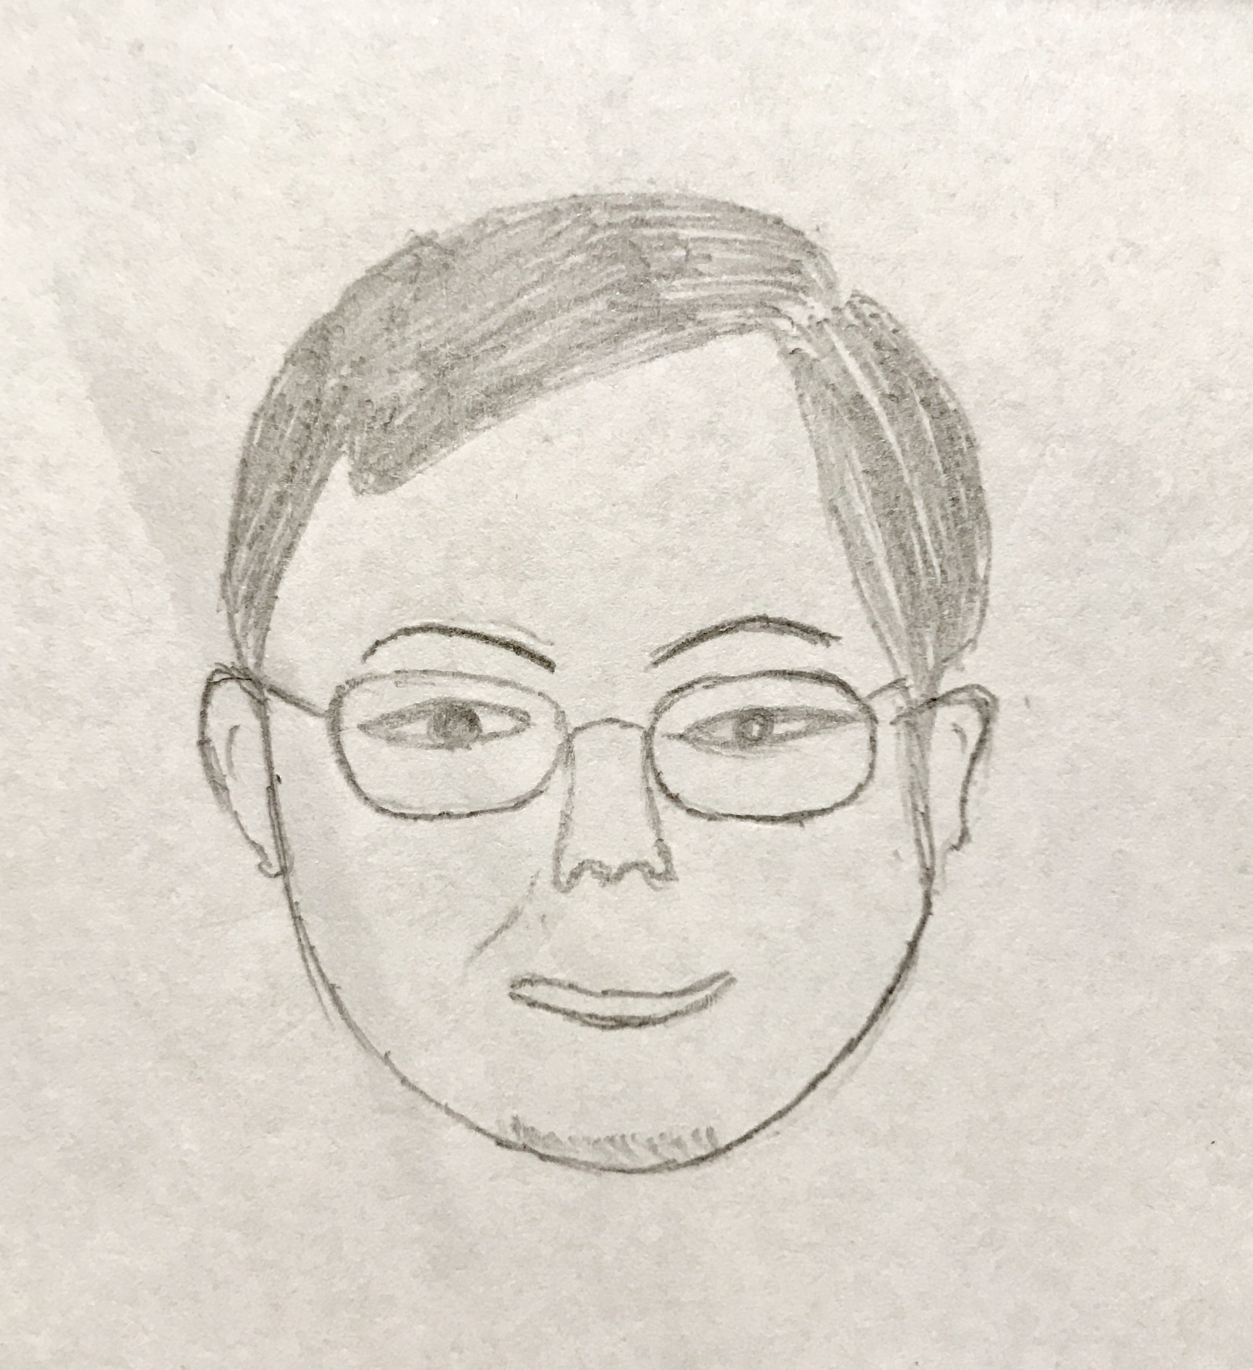
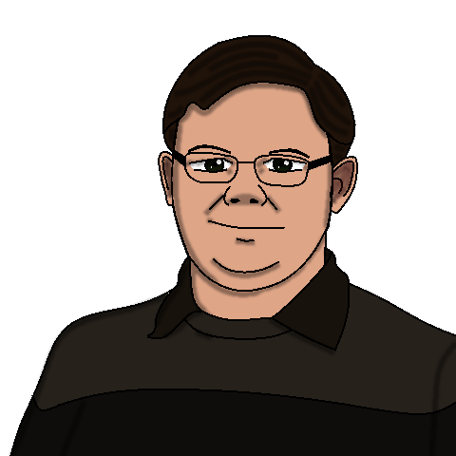
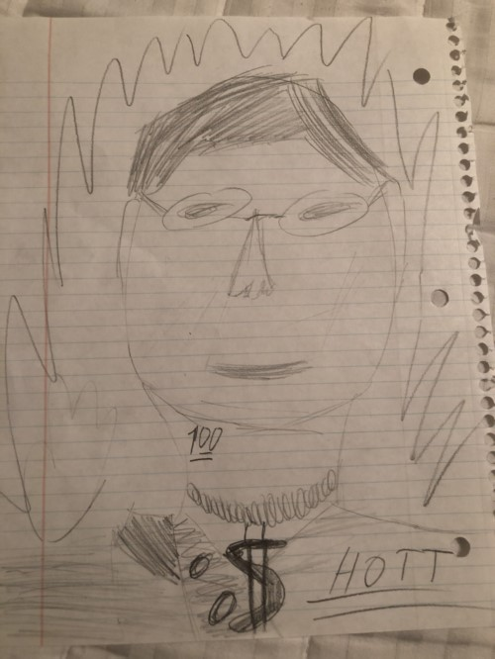


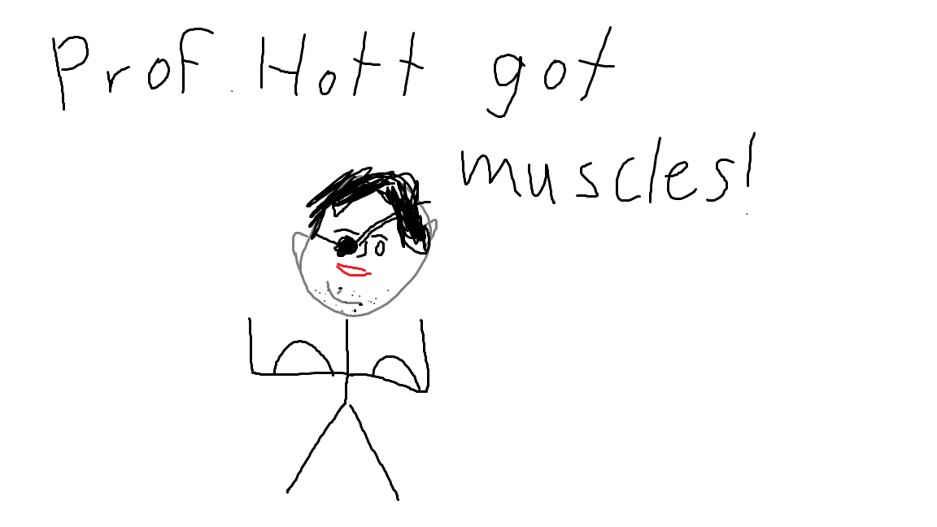



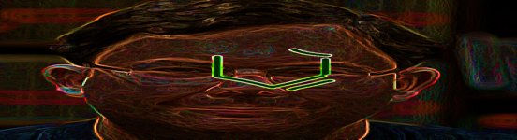
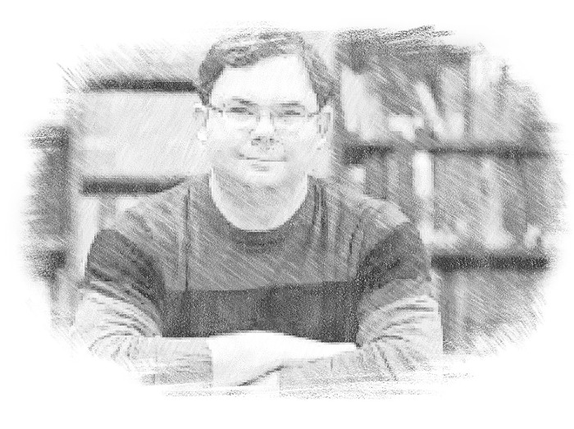
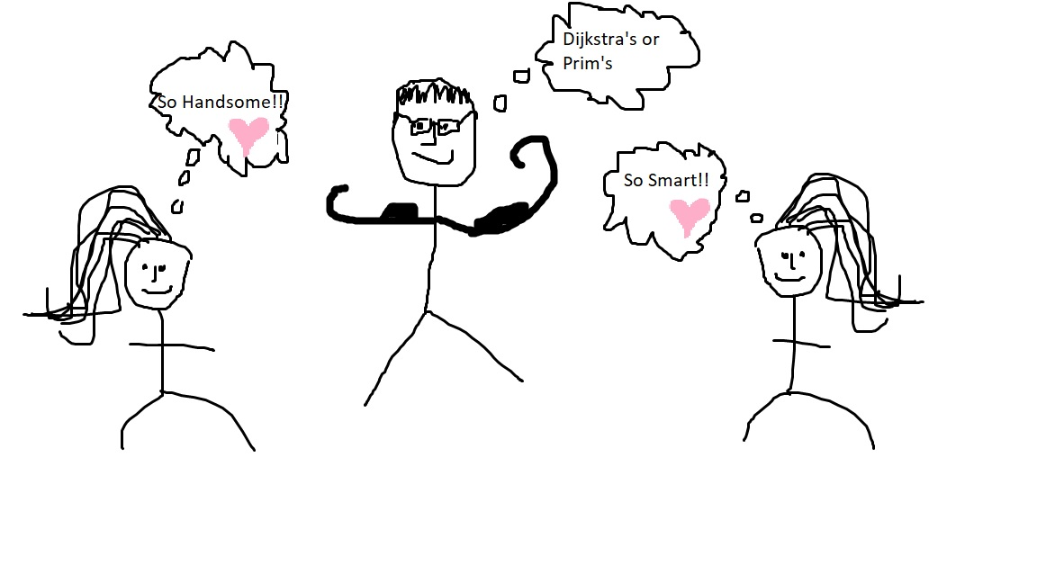
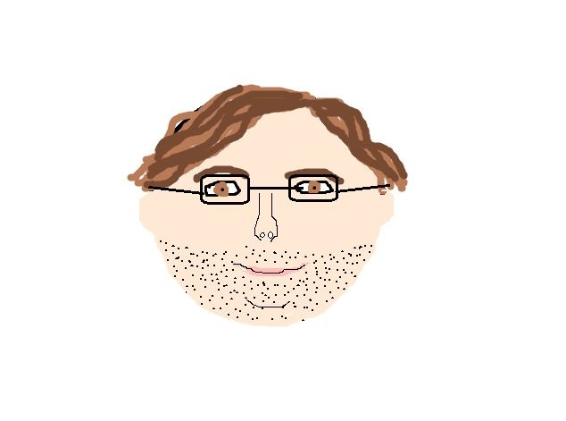

CS4102 Algorithms
Fall 2018

Slide 2
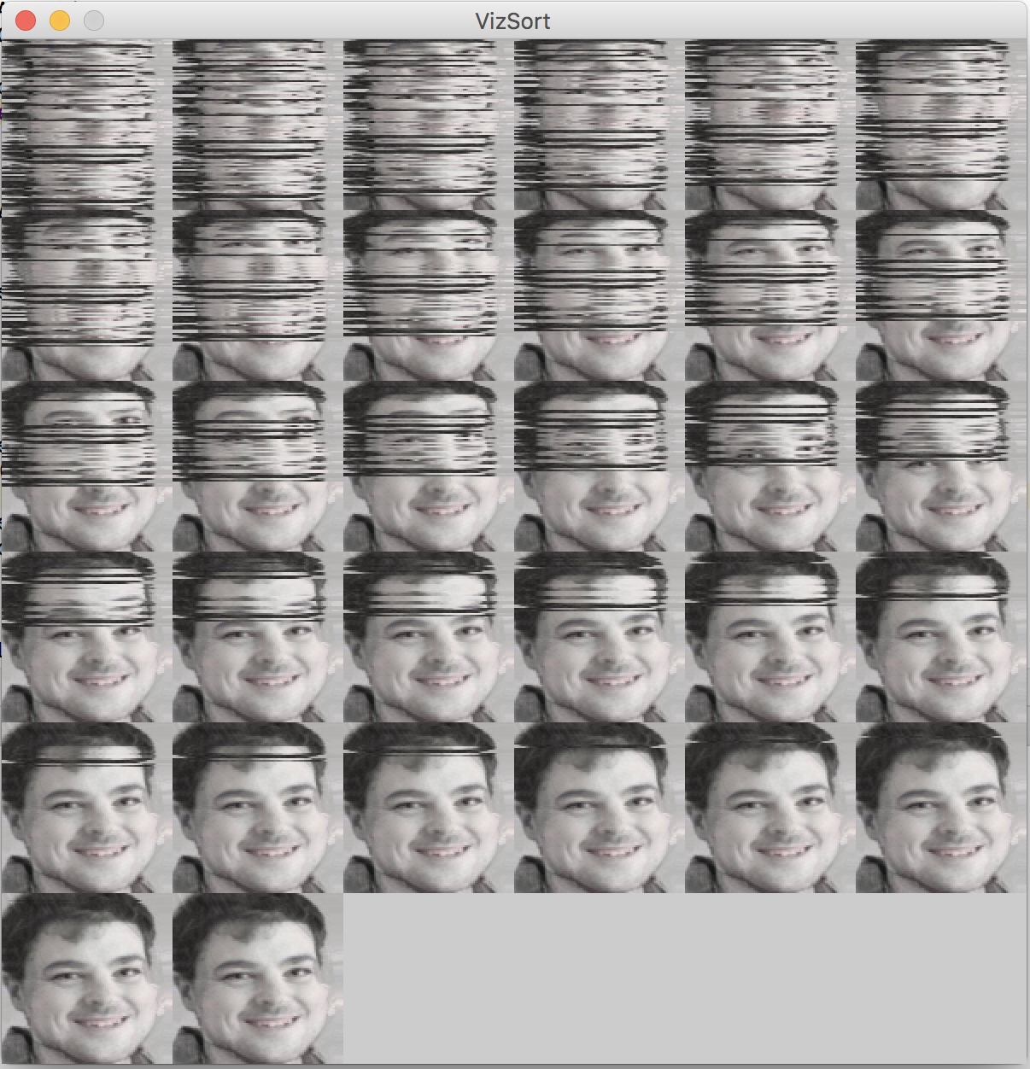
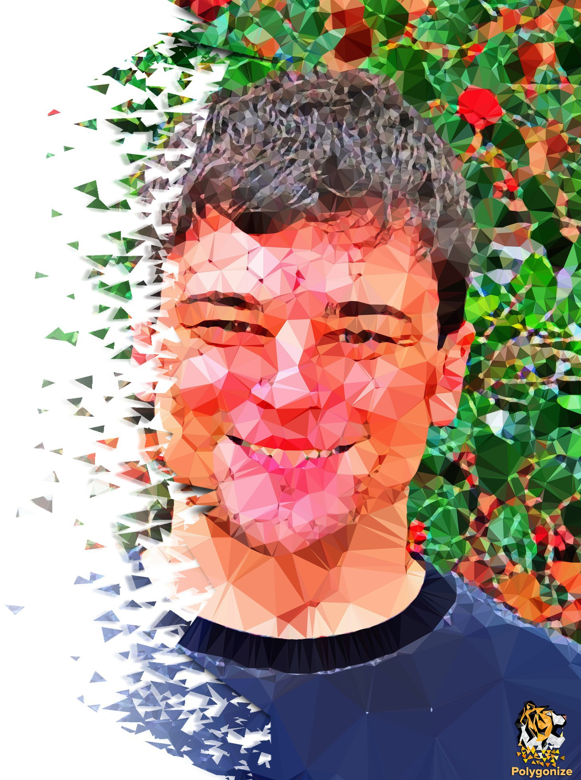
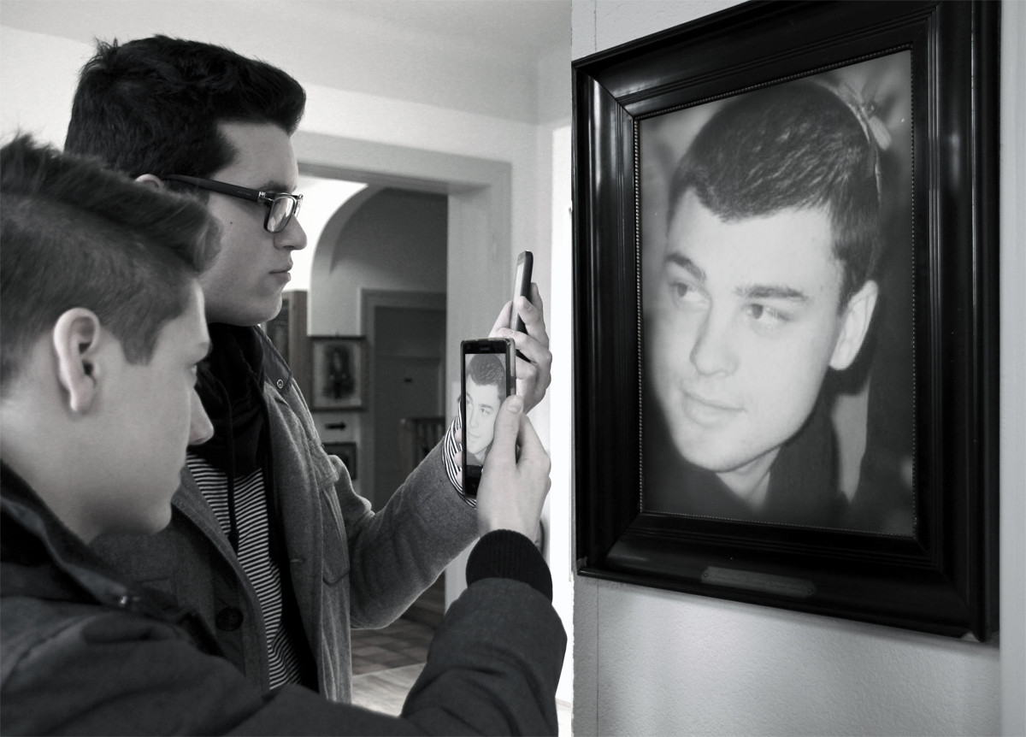

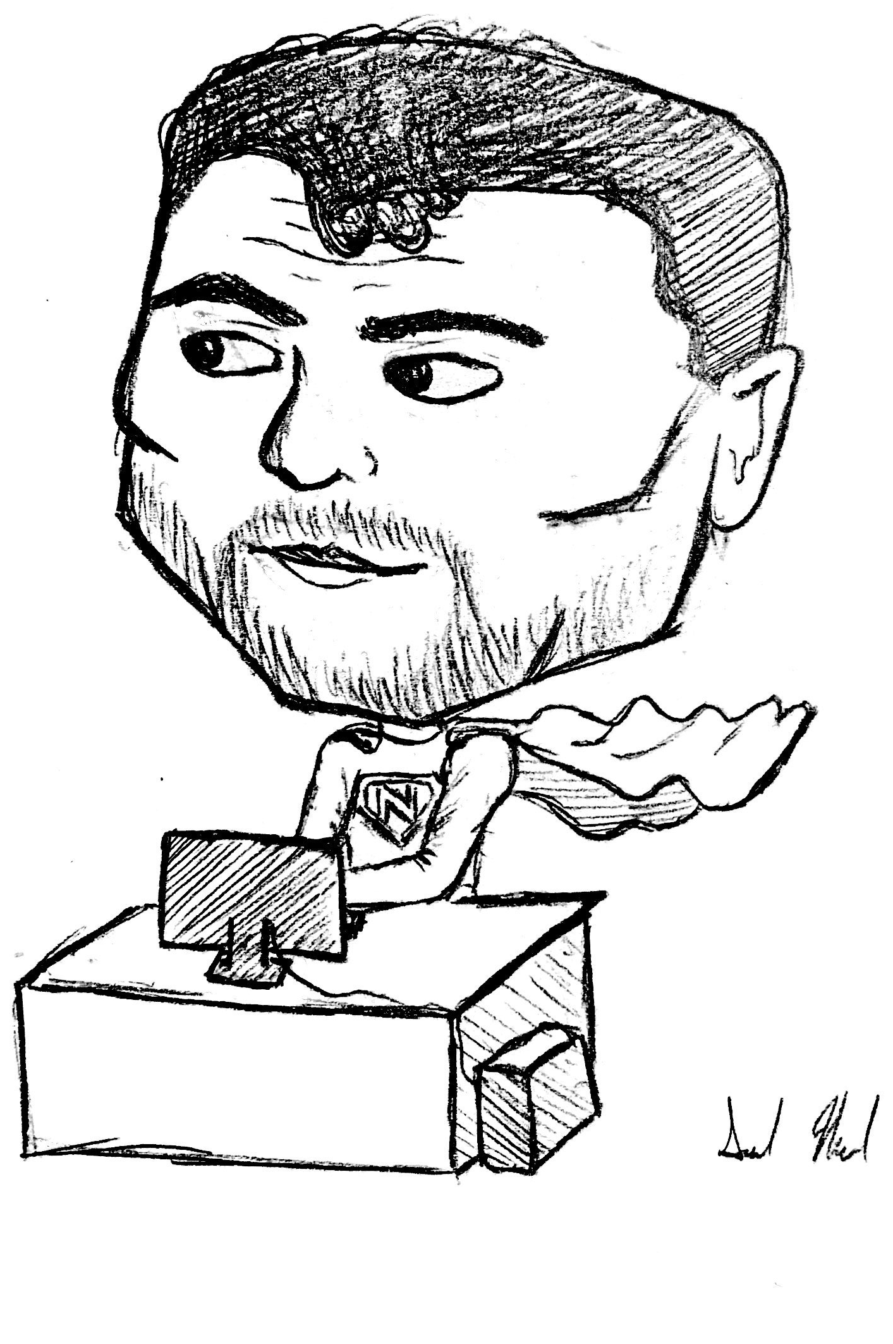
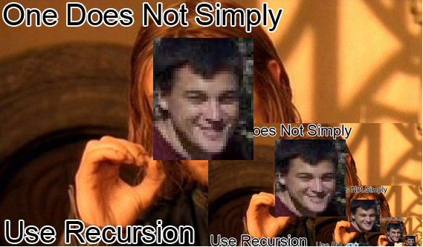

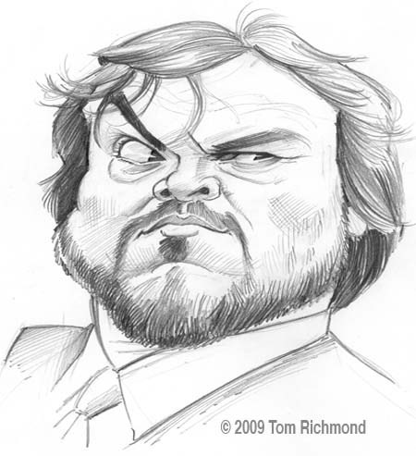
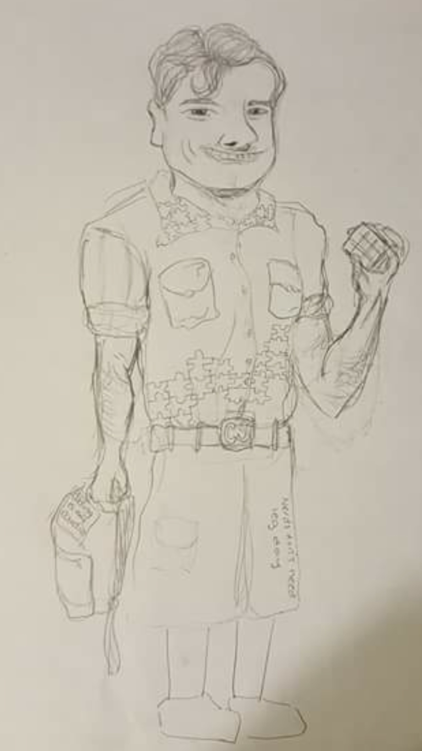
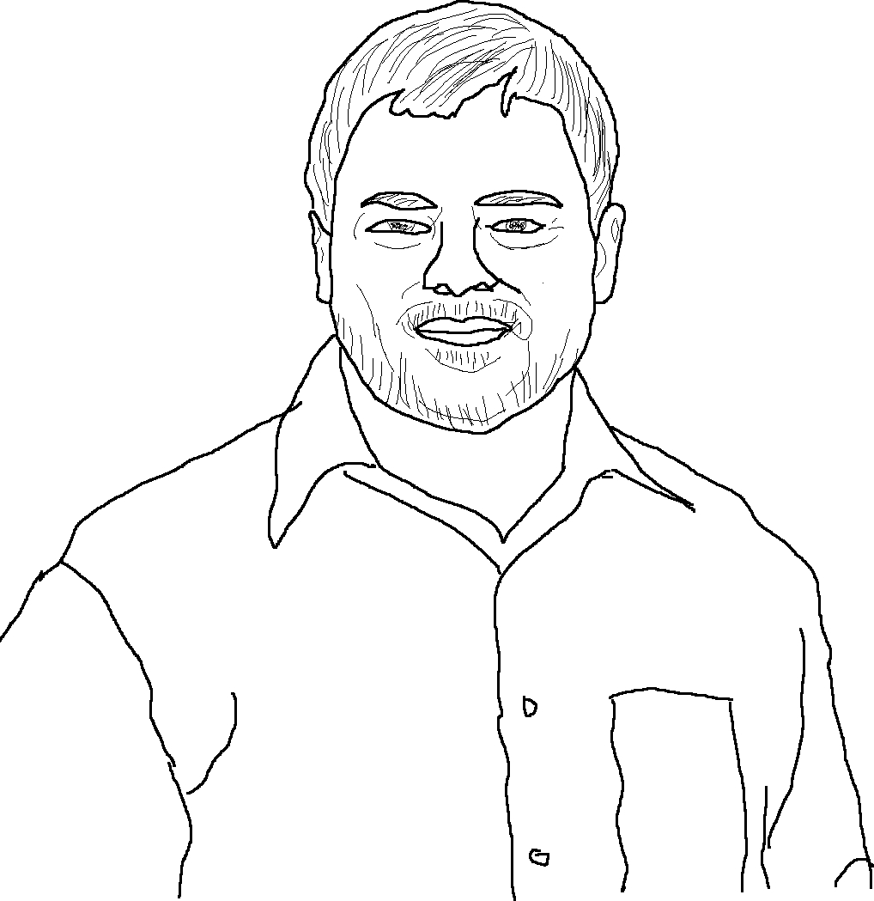

CS4102 Algorithms
Fall 2018

Slide 3

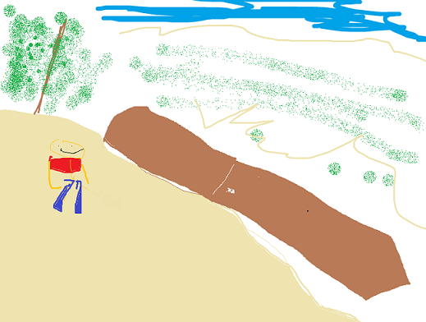


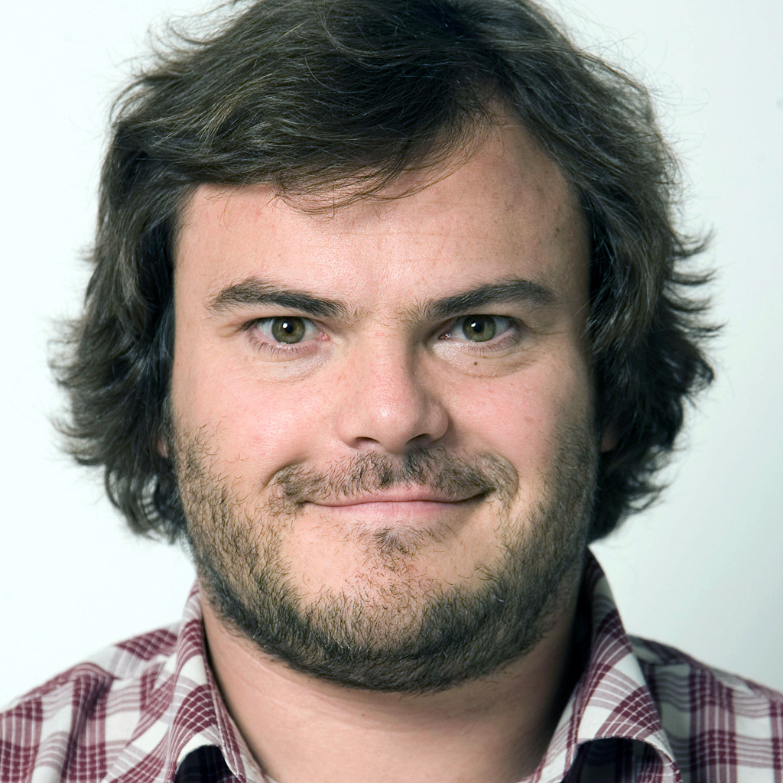
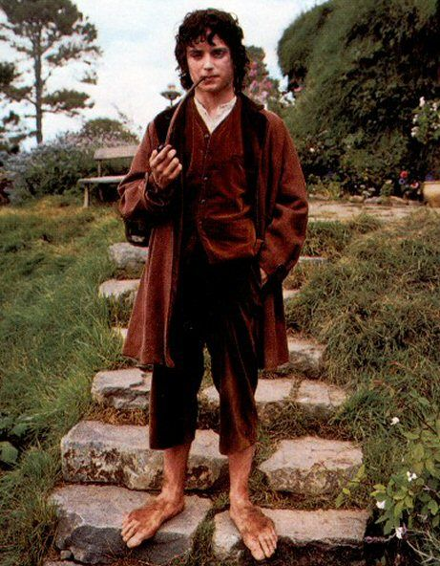



CS4102 Algorithms
Fall 2018

Slide 4
Today’s Keywords
Graphs
MaxFlow/MinCut
Ford-Fulkerson
Edmunds-Karp

Slide 5
CLRS Readings
Chapter 25
Chapter 26

Slide 6
Homeworks
HW8 due Friday 11/30 at 11pm
Written (use LaTeX)
Graphs

Slide 7
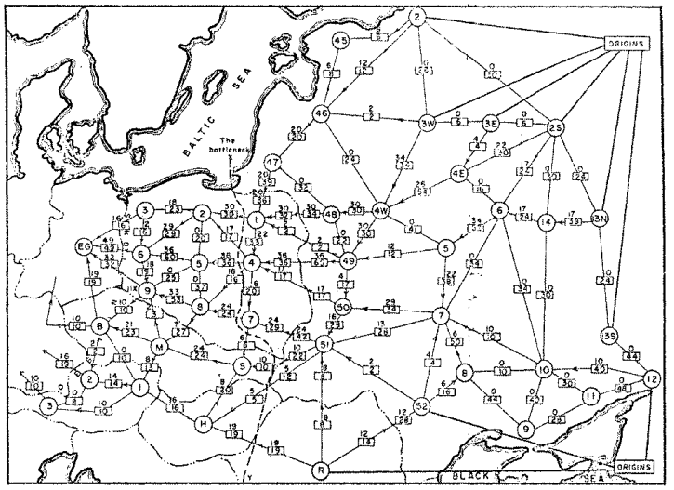
Max Flow / Min Cut
Railway map of Western USSR, 1955

Slide 8

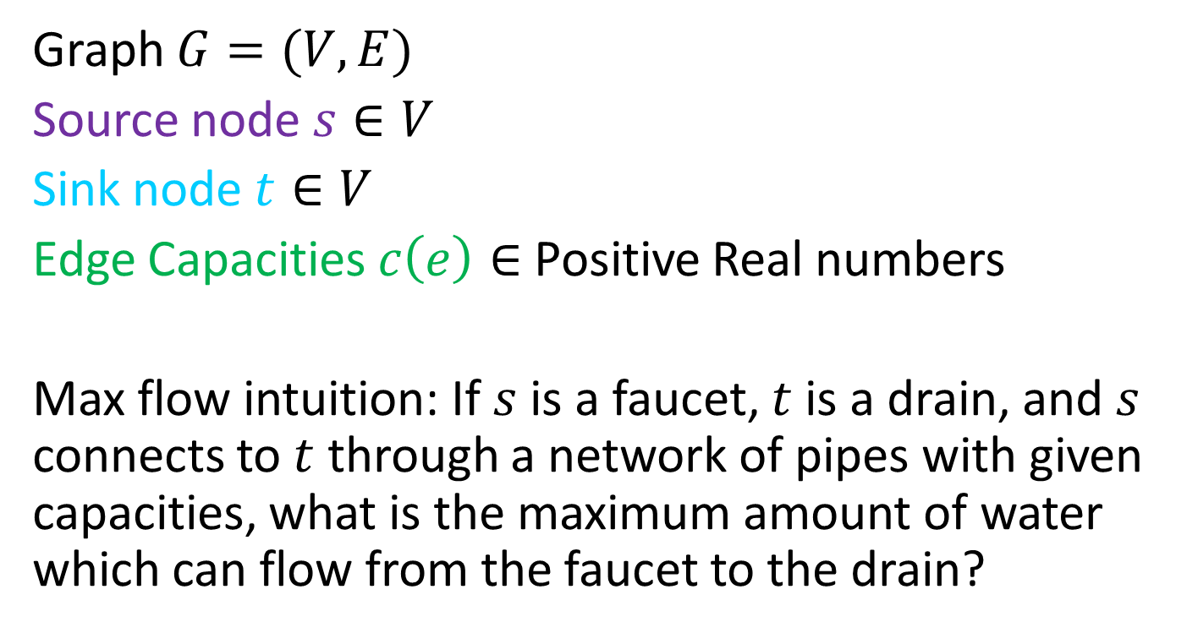

Flow Network
3
2
3
Graph $G=(V,E)$
Source node $s∈V$
Sink node $t∈V$
Edge Capacities $c\left(e\right)∈$ Positive Real numbers
Max flow intuition: If $s$ is a faucet, $t$ is a drain, and $s$ connects to $t$ through a network of pipes with given capacities, what is the maximum amount of water which can flow from the faucet to the drain?
$$s$$
3
2
$$t$$
2
1
3
1
2
3

Slide 9

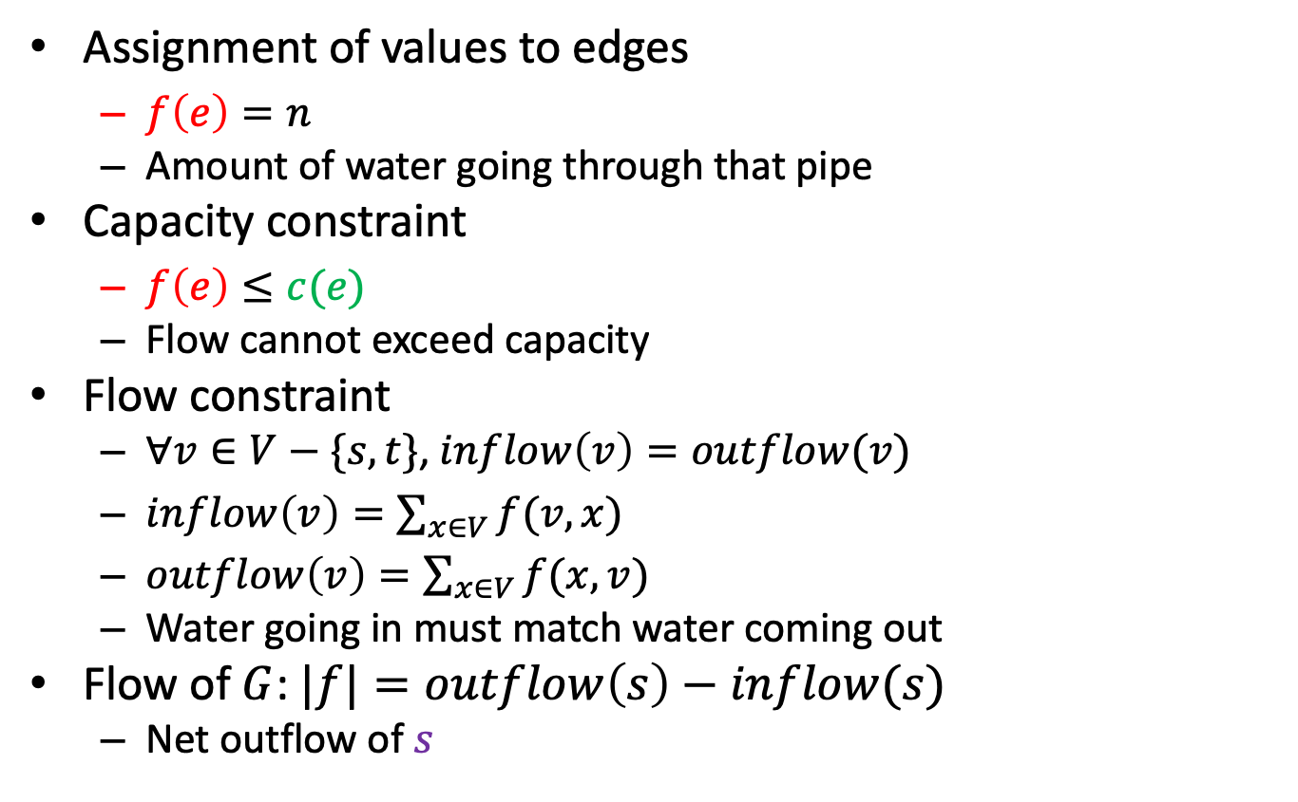

Flow
1/3
2/2
2/3
$$s$$
1/3
1/1
2/2
1/2
$$t$$
2/3
Assignment of values to edges
$f\left(e\right)=n$
Amount of water going through that pipe
Capacity constraint
$f\left(e\right)≤c(e)$
Flow cannot exceed capacity
Flow constraint
$∀v∈V−\{s,t\}$, $inflow\left(v\right)=outflow(v)$
$inflow\left(v\right)=\sum_{x∈V}{f(v,x)}$
$outflow\left(v\right)=\sum_{x∈V}{f(x,v)}$
Water going in must match water coming out
Flow of $G$: $|f|=outflow\left(s\right)−inflow(s)$
Net outflow of $s$
0/1
1/2
2/3
Flow/Capacity
3 in example above

Slide 10
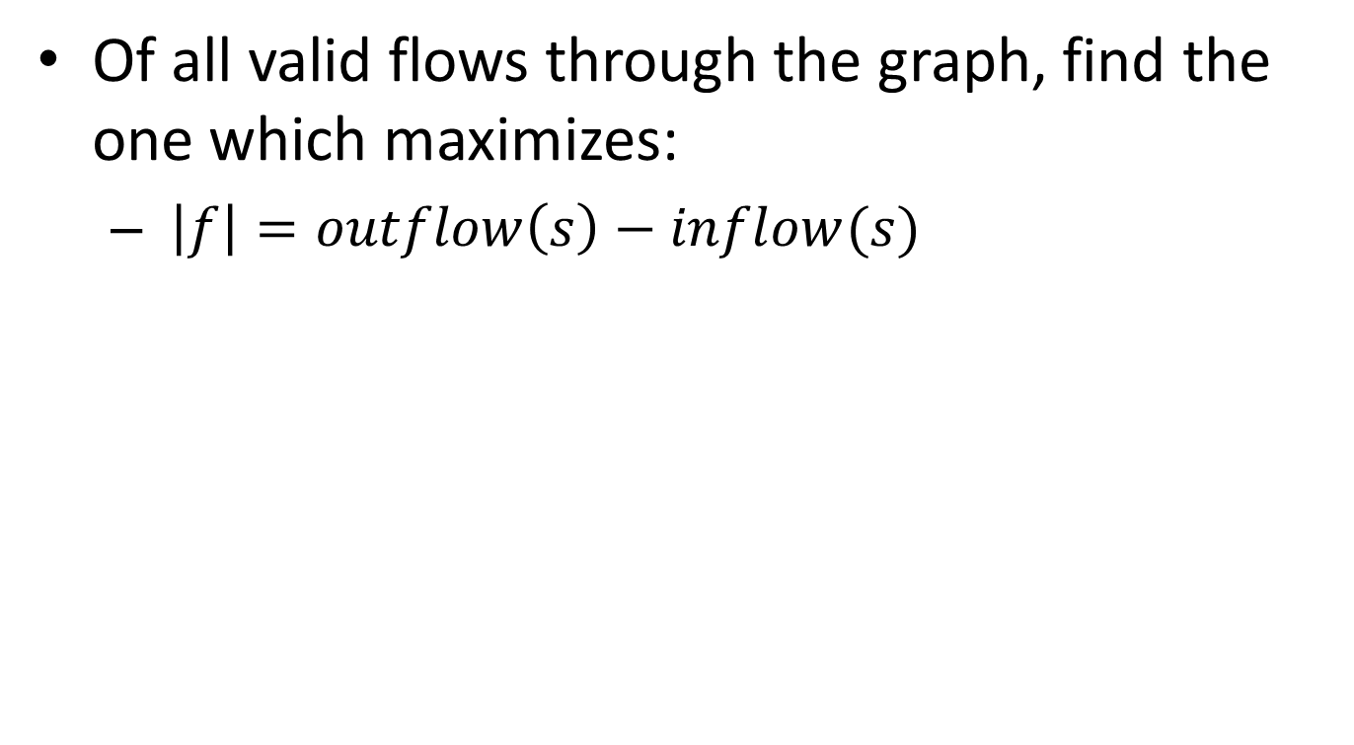
Max Flow
Of all valid flows through the graph, find the one which maximizes:
$\left|f\right|=outflow\left(s\right)−inflow(s)$

Slide 11


Greedy doesn’t work
Saturate Highest Capacity Path First
20
10
$$s$$
30
$$t$$
20
10

Slide 12
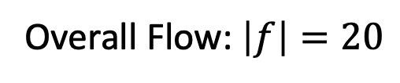
Greedy doesn’t work
Saturate Highest Capacity Path First
20/20
0/10
$$s$$
20/30
$$t$$
0/10
20/20
Overall Flow: $\left|f\right|=20$

Slide 13
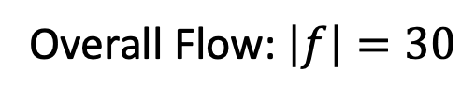
Greedy doesn’t work
Better Solution
20/20
10/10
$$s$$
10/30
$$t$$
10/10
20/20
Overall Flow: $\left|f\right|=30$

Slide 14
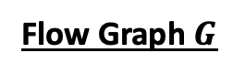
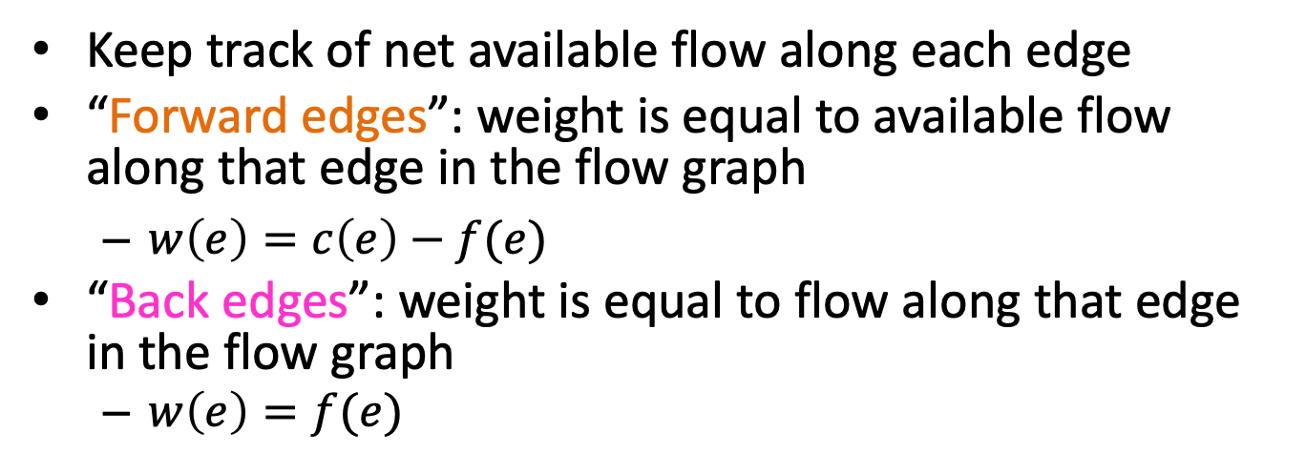





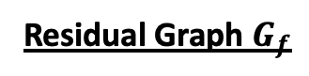
Residual Graph $G_{f}$
Keep track of net available flow along each edge
“Forward edges”: weight is equal to available flow along that edge in the flow graph
$w\left(e\right)=c\left(e\right)−f(e)$
“Back edges”: weight is equal to flow along that edge in the flow graph
$w\left(e\right)=f(e)$
Residual Graph $G_{f}$
Flow Graph $G$
1
2
1/3
2/2
0
2
2/3
2
$$s$$
1/3
1/1
$$s$$
1
1
1/2
$$t$$
1
2/2
2/3
2
0
3
$$t$$
0
2
3
1
1
0/1
1/2
1
2/3
2

Slide 15








Residual Graphs Example
Flow Graph
Residual Graph
20
0
10
0
20/20
0/10
$$s$$
20
$$t$$
$$s$$
20/30
$$t$$
10
10
0
20/20
0
20
0/10
20
20/20
10
10/10
0
0
$$s$$
10/30
$$t$$
$$s$$
20
10
$$t$$
0
0
10/10
20/20
10
20

Slide 16
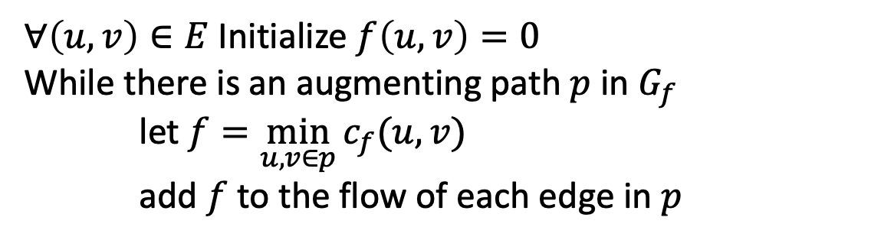
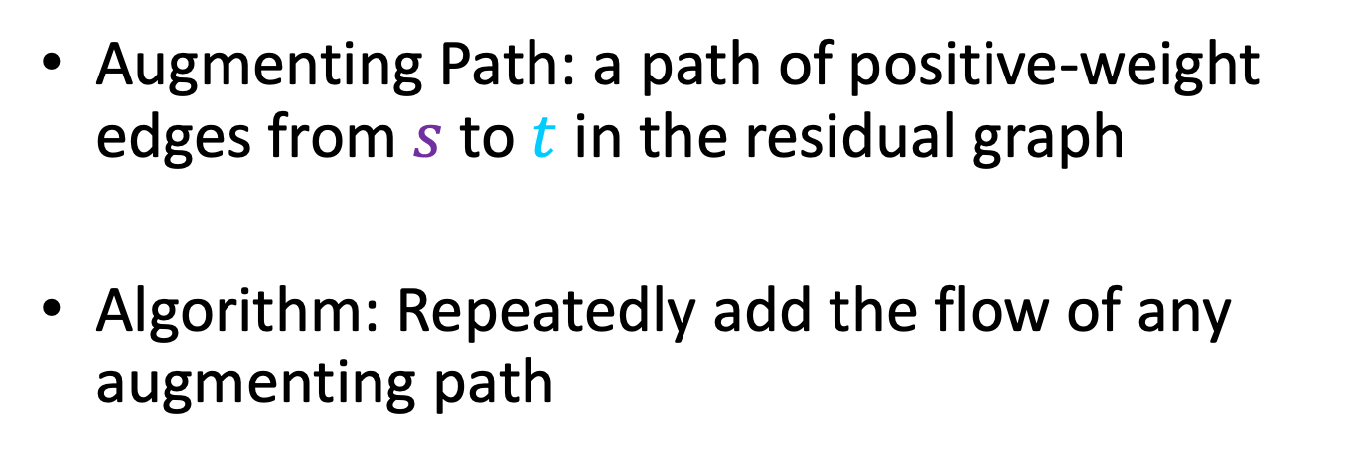
Ford-Fulkerson
Augmenting Path: a path of positive-weight edges from $s$ to $t$ in the residual graph
Algorithm: Repeatedly add the flow of any augmenting path
$∀\left(u,v\right)∈E$Initialize $f\left(u,v\right)=0$
While there is an augmenting path $p$ in $G_{f}$
let $f=\min_{u,v∈p}{c_{f}(u,v)}$
add $f$ to the flow of each edge in $p$

Slide 17




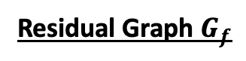
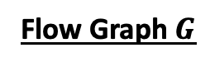
Ford Fulkerson: example
Residual Graph $G_{f}$
Flow Graph $G$
0/3
0/2
0
0
0/3
2
$$s$$
3
0
0/3
0/1
0/2
0/2
$$t$$
$$s$$
0
3
0/3
0
3
1
2
$$t$$
2
3
0/1
0/2
2
0/3
1
0
3
0
Add flow of 1 to this path

Slide 18
Ford Fulkerson: example
Residual Graph $G_{f}$
Flow Graph $G$
1/3
1/2
1
1
0/3
1
$$s$$
2
0
0/3
1/1
0/2
0/2
$$t$$
$$s$$
1
3
0/3
0
3
0
2
$$t$$
2
3
0/1
1/2
1
1/3
1
1
2
1
Add flow of 1 to this path

Slide 19
Ford Fulkerson: example
Residual Graph $G_{f}$
Flow Graph $G$
1/3
1/2
1
1
1/3
1
$$s$$
2
1
0/3
0/1
1/2
0/2
$$t$$
$$s$$
0
2
0/3
0
3
1
2
$$t$$
1
3
0/1
1/2
1
1/3
2
1
2
1
Add flow of 1 to this path

Slide 20
Ford Fulkerson: example
Residual Graph $G_{f}$
Flow Graph $G$
2/3
2/2
2
2
2/3
0
$$s$$
1
2
0/3
0/1
1/2
0/2
$$t$$
$$s$$
0
1
0/3
0
3
1
2
$$t$$
1
3
0/1
1/2
1
1/3
2
1
2
1

Slide 21
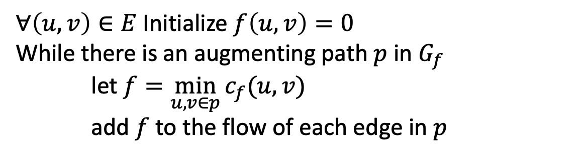
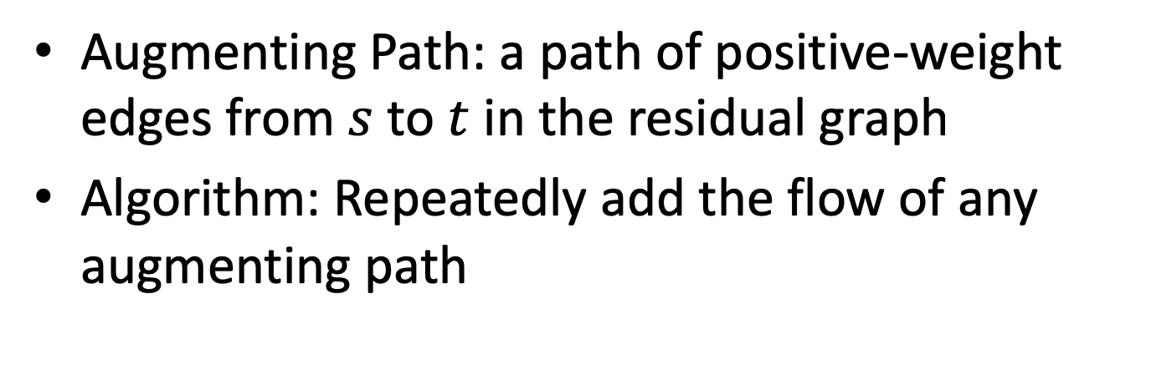
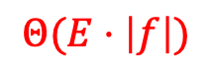

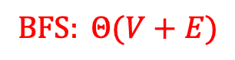
Ford-Fulkerson: Run Time
Augmenting Path: a path of positive-weight edges from $s$ to $t$ in the residual graph
Algorithm: Repeatedly add the flow of any augmenting path
$∀\left(u,v\right)∈E$Initialize $f\left(u,v\right)=0$
While there is an augmenting path $p$ in $G_{f}$
let $f=\min_{u,v∈p}{c_{f}(u,v)}$
add $f$ to the flow of each edge in $p$
Time to find an augmenting path:
$$BFS: Θ(V+E)$$
$$Θ(E⋅\left|f\right|)$$
Number of iterations of While loop:
$$|f|$$

Slide 22


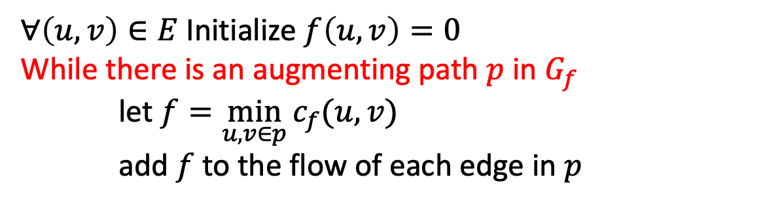
Why might we loop $|f|$ times?
$∀\left(u,v\right)∈E$Initialize $f\left(u,v\right)=0$
While there is an augmenting path $p$ in $G_{f}$
let $f=\min_{u,v∈p}{c_{f}(u,v)}$
add $f$ to the flow of each edge in $p$
0
0/100
0
0/100
100
100
$$s$$
0/1
$$t$$
$$s$$
0
$$t$$
1
100
100
0/100
0/100
0
0

Slide 23
Why might we loop $|f|$ times?
$∀\left(u,v\right)∈E$Initialize $f\left(u,v\right)=0$
While there is an augmenting path $p$ in $G_{f}$
let $f=\min_{u,v∈p}{c_{f}(u,v)}$
add $f$ to the flow of each edge in $p$
1
1/100
0
0/100
99
100
$$s$$
1/1
$$t$$
$$s$$
1
$$t$$
0
100
99
0/100
1/100
0
1

Slide 24
Why might we loop $|f|$ times?
$∀\left(u,v\right)∈E$Initialize $f\left(u,v\right)=0$
While there is an augmenting path $p$ in $G_{f}$
let $f=\min_{u,v∈p}{c_{f}(u,v)}$
add $f$ to the flow of each edge in $p$
1
1/100
1
1/100
99
99
$$s$$
0/1
$$t$$
$$s$$
0
$$t$$
1
99
99
1/100
1/100
1
1

Slide 25
Why might we loop $|f|$ times?
$∀\left(u,v\right)∈E$Initialize $f\left(u,v\right)=0$
While there is an augmenting path $p$ in $G_{f}$
let $f=\min_{u,v∈p}{c_{f}(u,v)}$
add $f$ to the flow of each edge in $p$
Each time we increase flow by 1
Loop runs 200 times
2
2/100
1
1/100
98
99
$$s$$
1/1
$$t$$
$$s$$
0
$$t$$
1
99
98
1/100
2/100
1
2

Slide 26
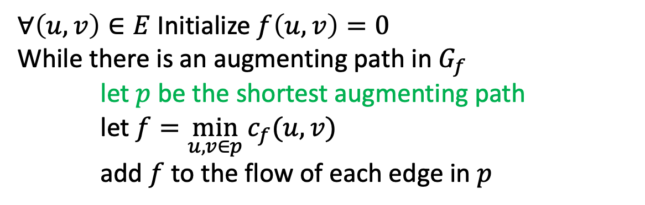
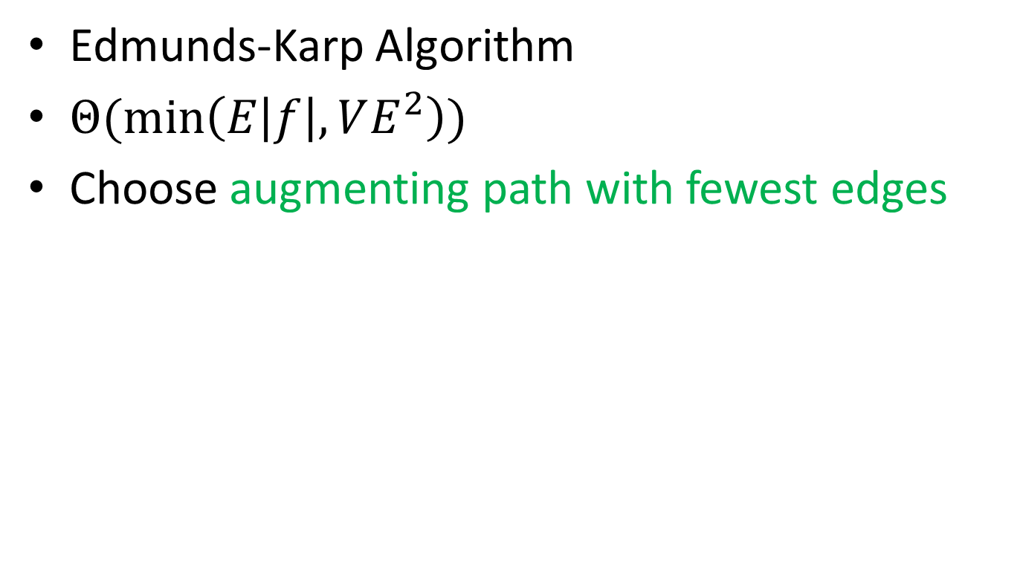
Can We Avoid this?
Edmunds-Karp Algorithm
$Θ(\min\left(E\left|f\right|, VE^{2}\right))$
Choose augmenting path with fewest edges
$∀\left(u,v\right)∈E$Initialize $f\left(u,v\right)=0$
While there is an augmenting path in $G_{f}$
let $p$ be the shortest augmenting path
let $f=\min_{u,v∈p}{c_{f}(u,v)}$
add $f$ to the flow of each edge in $p$

Slide 27
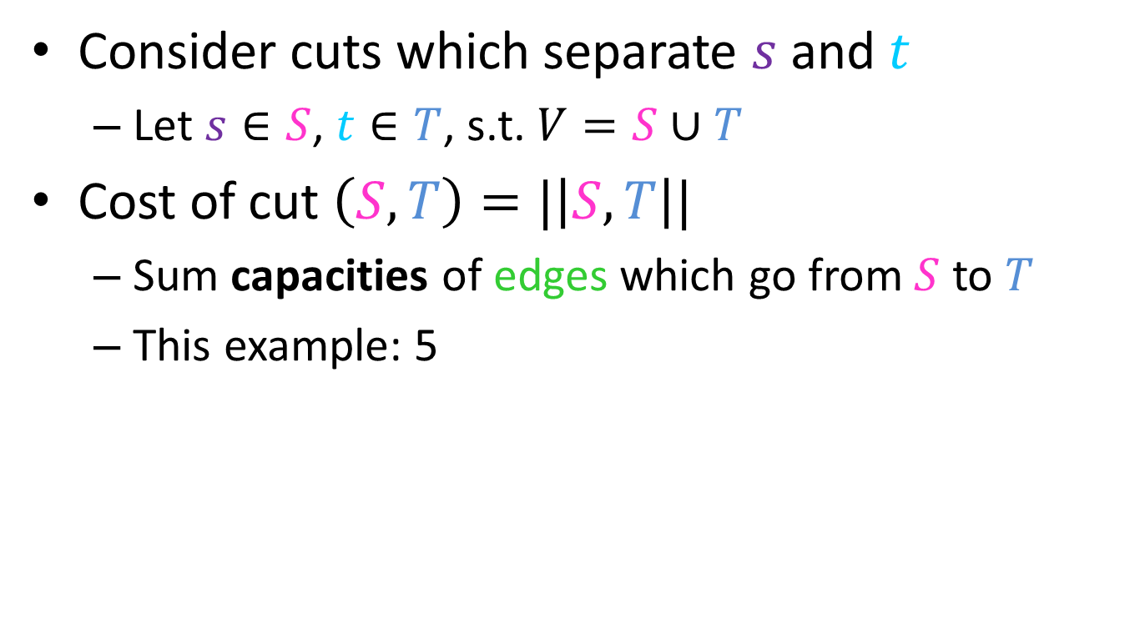



Showing Correctness of Ford-Fulkerson
Consider cuts which separate $s$ and $t$
Let $s∈S$, $t∈T$, s.t. $V=S∪T$
Cost of cut $\left(S,T\right)=|\left|S,T\right||$
Sum capacities of edges which go from $S$ to $T$
This example: 5
$$S$$
2
3
$$T$$
3
$$s$$
3
2
$$t$$
2
1
3
1
2
3

Slide 28
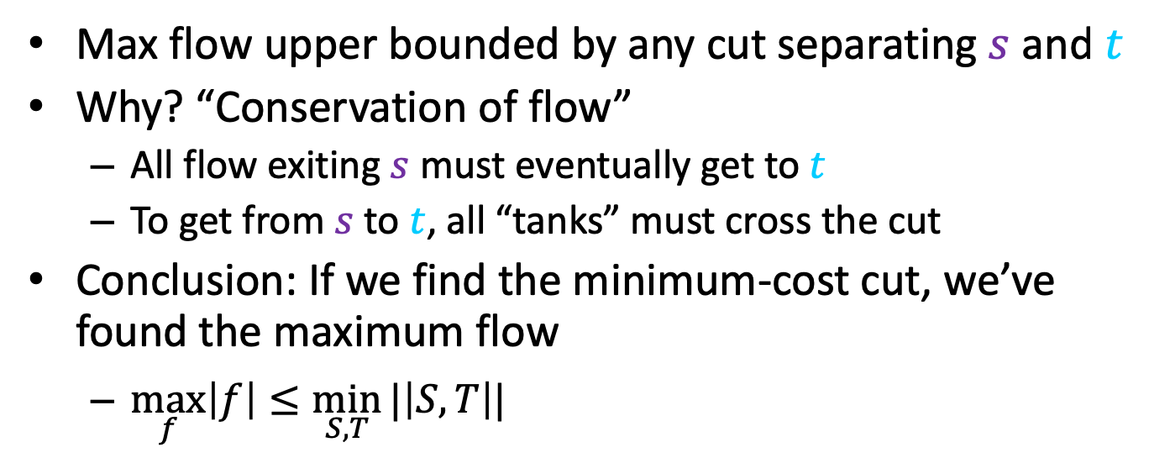

Maxflow$≤$MinCut
Formal proof in lecture supplemental
Max flow upper bounded by any cut separating $s$ and $t$
Why? “Conservation of flow”
All flow exiting $s$ must eventually get to $t$
To get from $s$ to $t$, all “tanks” must cross the cut
Conclusion: If we find the minimum-cost cut, we’ve found the maximum flow
$\max_{f}\left|f\right|≤\min_{S,T}{|\left|S,T\right||}$
$$S$$
2
3
$$T$$
3
$$s$$
3
2
$$t$$
2
1
3
1
2
3

Slide 29
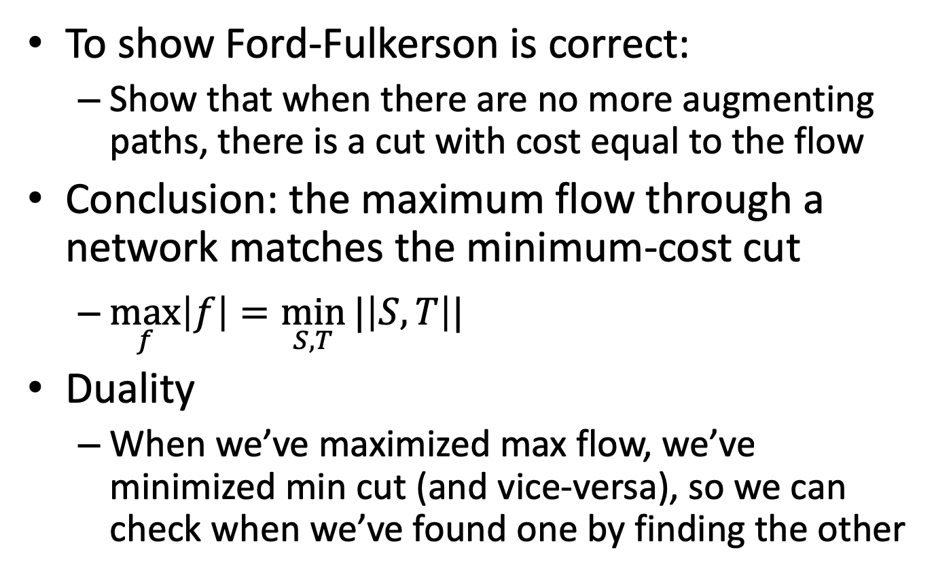
Maxflow/Mincut Theorem
To show Ford-Fulkerson is correct:
Show that when there are no more augmenting paths, there is a cut with cost equal to the flow
Conclusion: the maximum flow through a network matches the minimum-cost cut
$\max_{f}\left|f\right|=\min_{S,T}{|\left|S,T\right||}$
Duality
When we’ve maximized max flow, we’ve minimized min cut (and vice-versa), so we can check when we’ve found one by finding the other

Slide 30


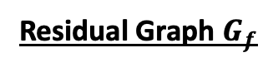
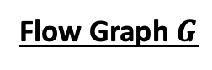

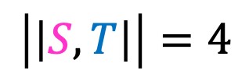
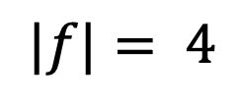
Example: Maxflow/Mincut
Flow Graph $G$
Residual Graph $G_{f}$
2
2
2/3
2/2
0
2
2/3
1
$$s$$
0/3
1/1
$$s$$
1
1
1/2
$$t$$
0
2/2
2/3
3
0
3
$$t$$
0
2
3
0
2
0/1
2/2
0
3/3
$$|f|= 4$$
3
No Augmenting Paths
$$\left|\left|S,T\right|\right|=4$$
Idea: When there are no more augmenting paths, there exists a cut in the graph with cost matching the flow
30

Slide 31
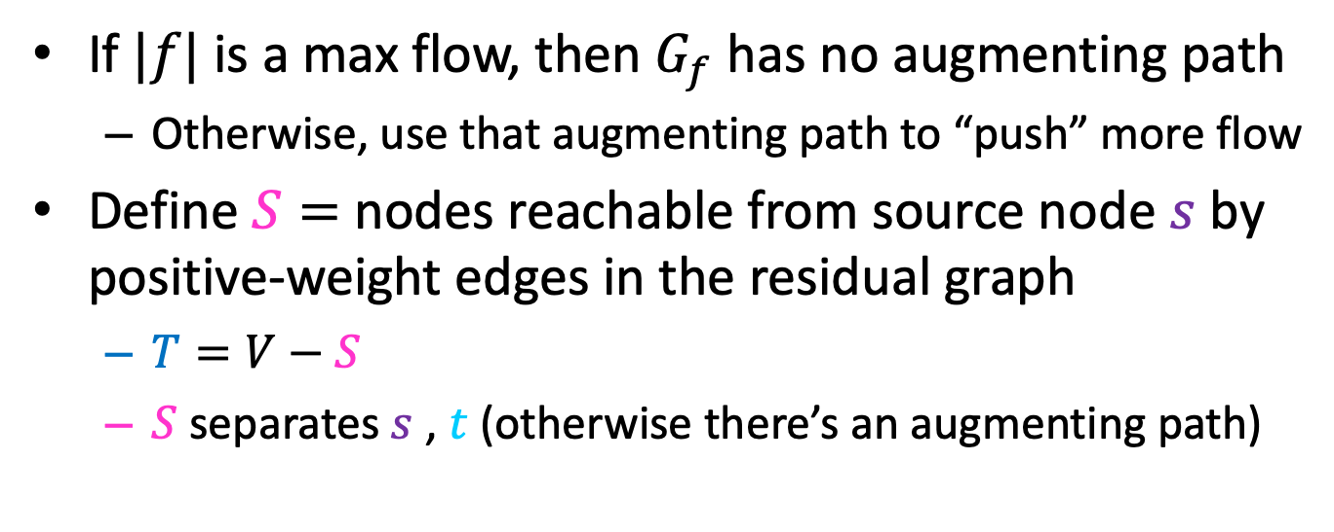
Proof: Maxflow/Mincut Theorem
If $|f|$ is a max flow, then $G_{f}$ has no augmenting path
Otherwise, use that augmenting path to “push” more flow
Define $S=$ nodes reachable from source node $s$ by positive-weight edges in the residual graph
$T=V−S$
$S$ separates $s$ , $t$ (otherwise there’s an augmenting path)
Flow Graph $G$
Residual Graph $G_{f}$
2
2
2/3
2/2
0
2
2/3
1
$$s$$
0/3
1/1
$$s$$
1
1
1/2
$$t$$
0
2/2
2/3
3
0
3
$$t$$
0
2
3
0
2
0/1
2/2
0
3/3
3

Slide 32
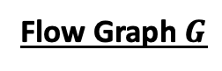
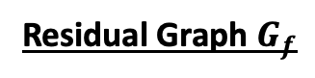
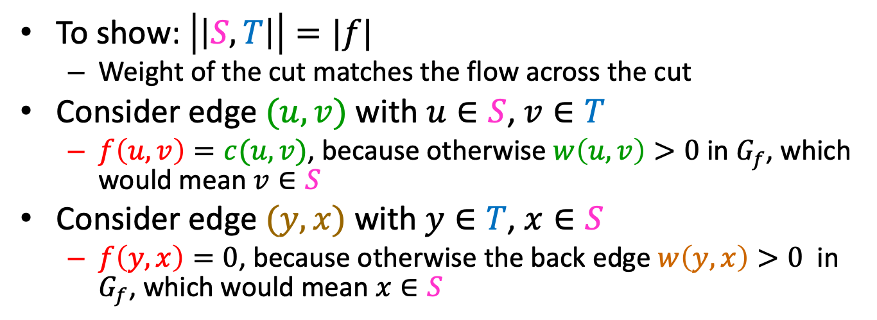
Proof: Maxflow/Mincut Theorem
To show: $\left|\left|S,T\right|\right|=|f|$
Weight of the cut matches the flow across the cut
Consider edge $(u,v)$ with $u∈S$, $v∈T$
$f\left(u,v\right)=c(u,v)$, because otherwise $w\left(u,v\right)>0$ in $G_{f}$, which would mean $v∈S$
Consider edge $(y,x)$ with $y∈T$, $x∈S$
$f\left(y,x\right)=0$, because otherwise the back edge $w\left(y,x\right)>0$ in $G_{f}$, which would mean $x∈S$
Flow Graph $G$
Residual Graph $G_{f}$
2
2
2/3
2/2
0
2
2/3
1
$$s$$
0/3
1/1
$$s$$
1
1
1/2
$$t$$
0
2/2
2/3
3
0
3
$$t$$
0
2
3
0
2
0/1
2/2
0
3/3
3

Slide 33

Proof Summary
The flow $|f|$ of $G$ is upper-bounded by the sum of capacities of edges crossing any cut separating source $s$ and sink $t$
When Ford-Fulkerson Terminates, there are no more augmenting paths in $G_{f}$
When there are no more augmenting paths in $G_{f}$ then we can define a cut $S=$ nodes reachable from source node $s$ by positive-weight edges in the residual graph
The sum of edge capacities crossing this cut must match the flow of the graph
Therefore this flow is maximal

Slide 34

Other Maxflow algorithms
Ford-Fulkerson
$Θ(E\left|f\right|)$
Edmonds-Karp
$Θ(E^{2}V)$
Push-Relabel (Tarjan)
$Θ(EV^{2})$
Faster Push-Relabel (also Tarjan)
$Θ(V^{3})$

